Slide 1
Easy Assembly Upholstered Platform Bed with Headboard 06
BMLY6UH_00__| Upholstered Platform Bed
FUXIYU Design team
04.28.2022

Slide 2
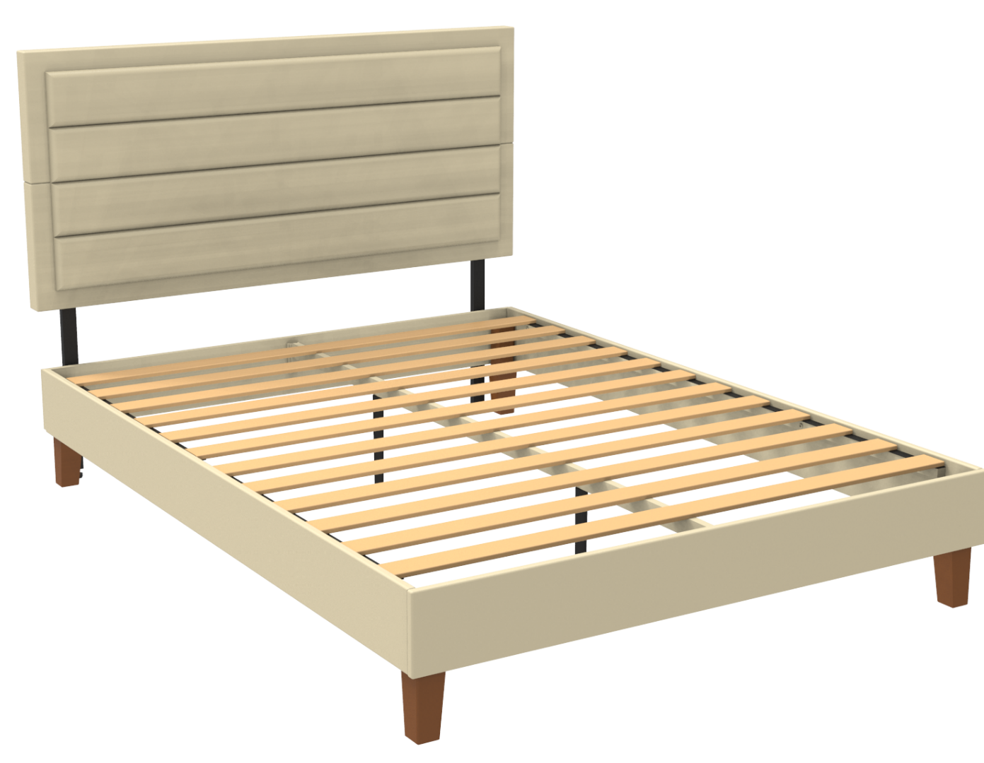
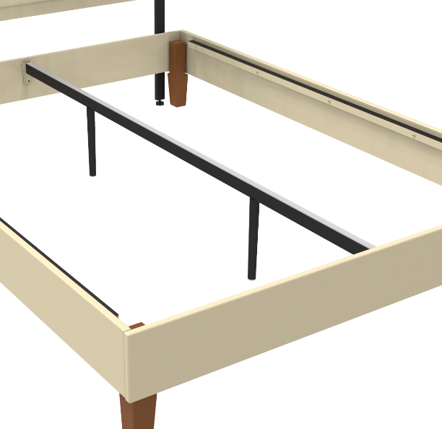
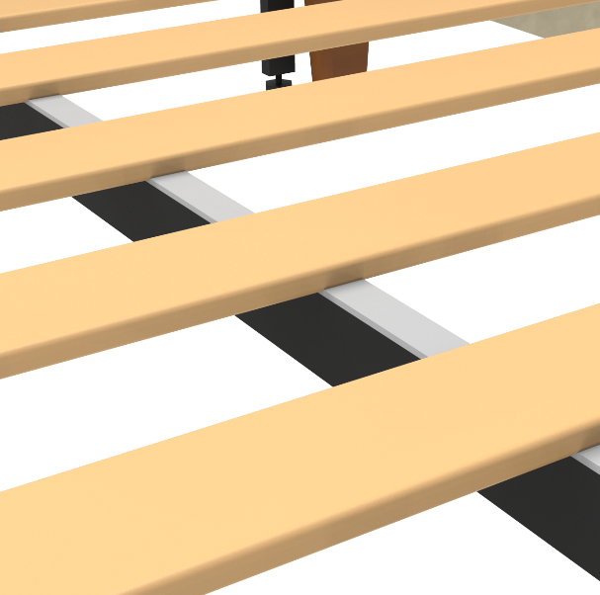
BMLY6UH_00__| Upholstered Platform Bed
PRODUCT DIMENSION
NOISE FREE
Twin 77” x 39” x 13.4”-F13.4”-H47”
Full 77” x 54” x 13.4”-F13.4”-H47”
Queen 82” x 60” x 13.4”-F13.4”-H47”
King 82” x 76” x 13.4”-F13.4”-H47”
HEAVY DUTY
WEIGHT
TOOL-FREE
Twin N.W: 70.0lbs | G.W: 77.2lbs
Full N.W: 92.6lbs | G.W: 99.9bs
Queen N.W: 97.9lbs | G.W: 106.7lbs
King N.W: 112.4lbs | G.W: 120.1lbs
NO BOX SPRING NEEDED
SLATS
THOUGHTFUL DESIGN
QUICK & EASY ASSEMBLY
Twin 12pcs/set
Full 12pcs/set
Queen 12pcs/set
King 12pcs/set
WEIGHT CAPACITY
Twin 350lbs
Full 700lbs
Queen 700lbs
King 700lbs
6”
TOOL FREE & QUICK LOCK
Quick-Lock feature makes assembling this furniture a piece of cake for anyone.
Sturdy & Durable Steel & Noise Free
Sturdy and durable of heavy duty steel center bar support with noise-free rubber pad, not only give stability and level support, but also help enhance platform bed life!
No box spring needed
The wood slat foundation offers all the support your foam, spring, or hybrid mattress needs without a box spring. Slats are spaced 3.43" apart in king and queen beds, and 2.95" in full and twin beds.
Low profile
Get the classic look of a low profile bed while still having 6" of clearance underneath to stash away your odds and ends under the bed to perfect that clean look of your bedroom!

Slide 3
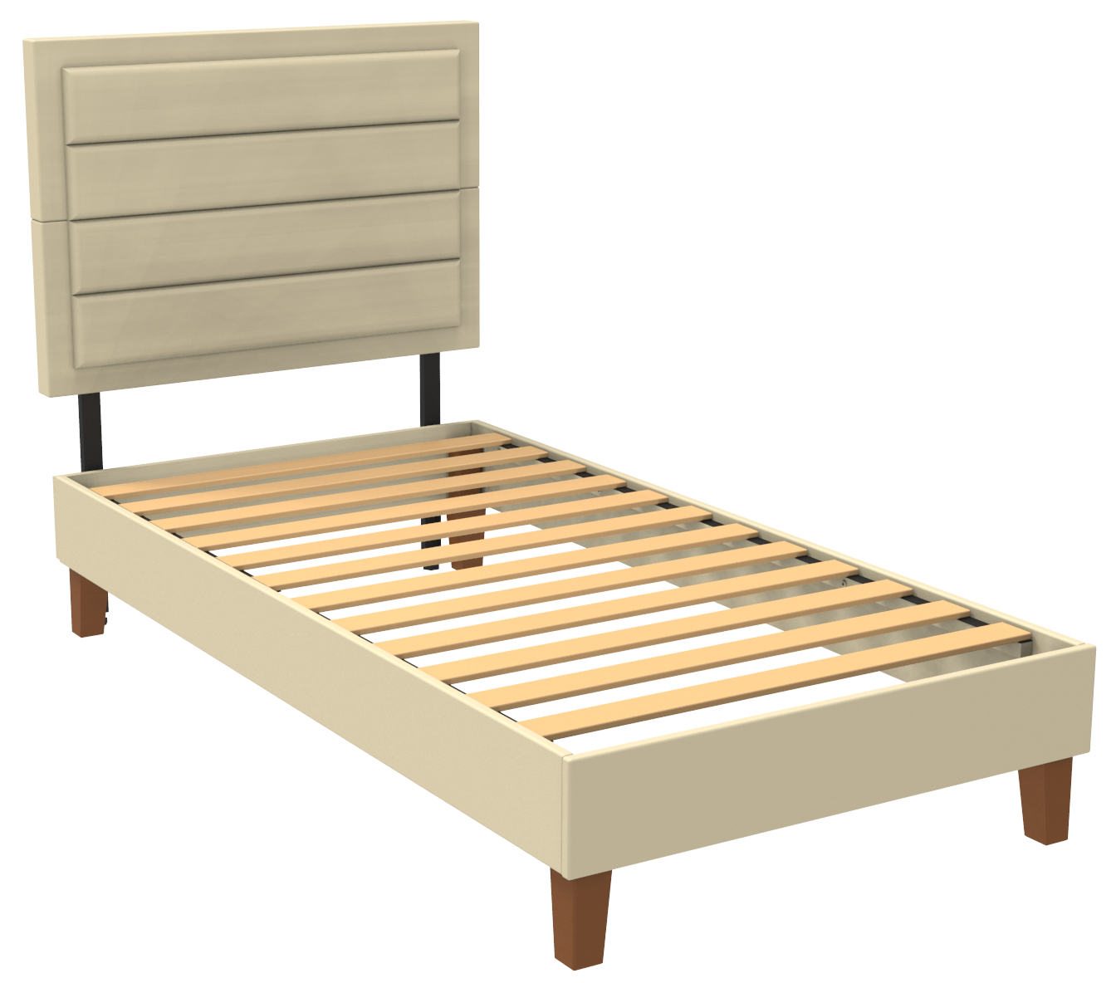
BMLY6UH_00__| Upholstered Platform Bed
TWIN SPEC
39.2”
27.6”
47”
6.4”
75.2”
2.95”
7”
13.4”
38.8”
76.7”
6”

Slide 4
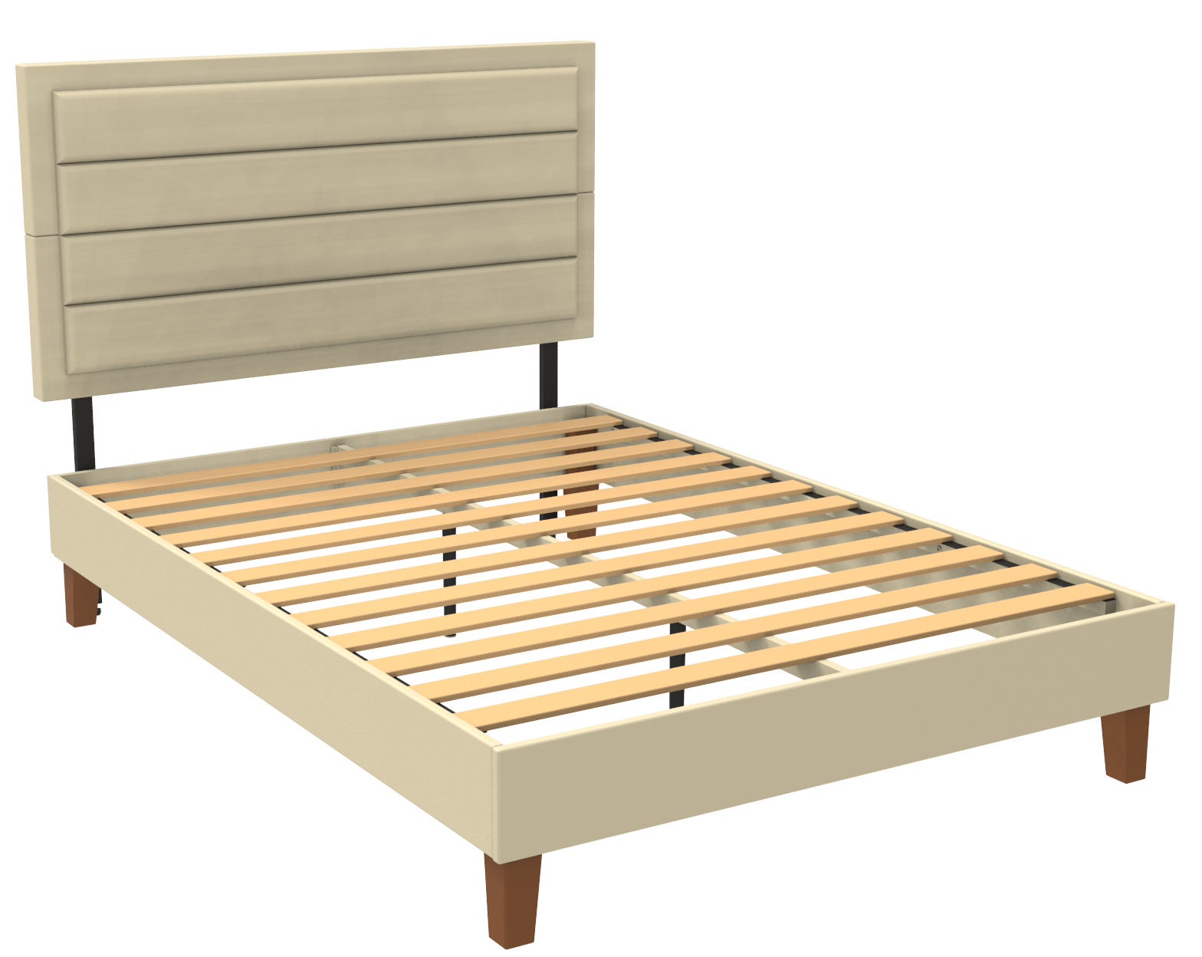
BMLY6UH_00__| Upholstered Platform Bed
FULL SPEC
54.2”
27.6”
47”
6.4”
75.2”
2.95”
13.4”
7”
53.8”
76.7”
6”

Slide 5
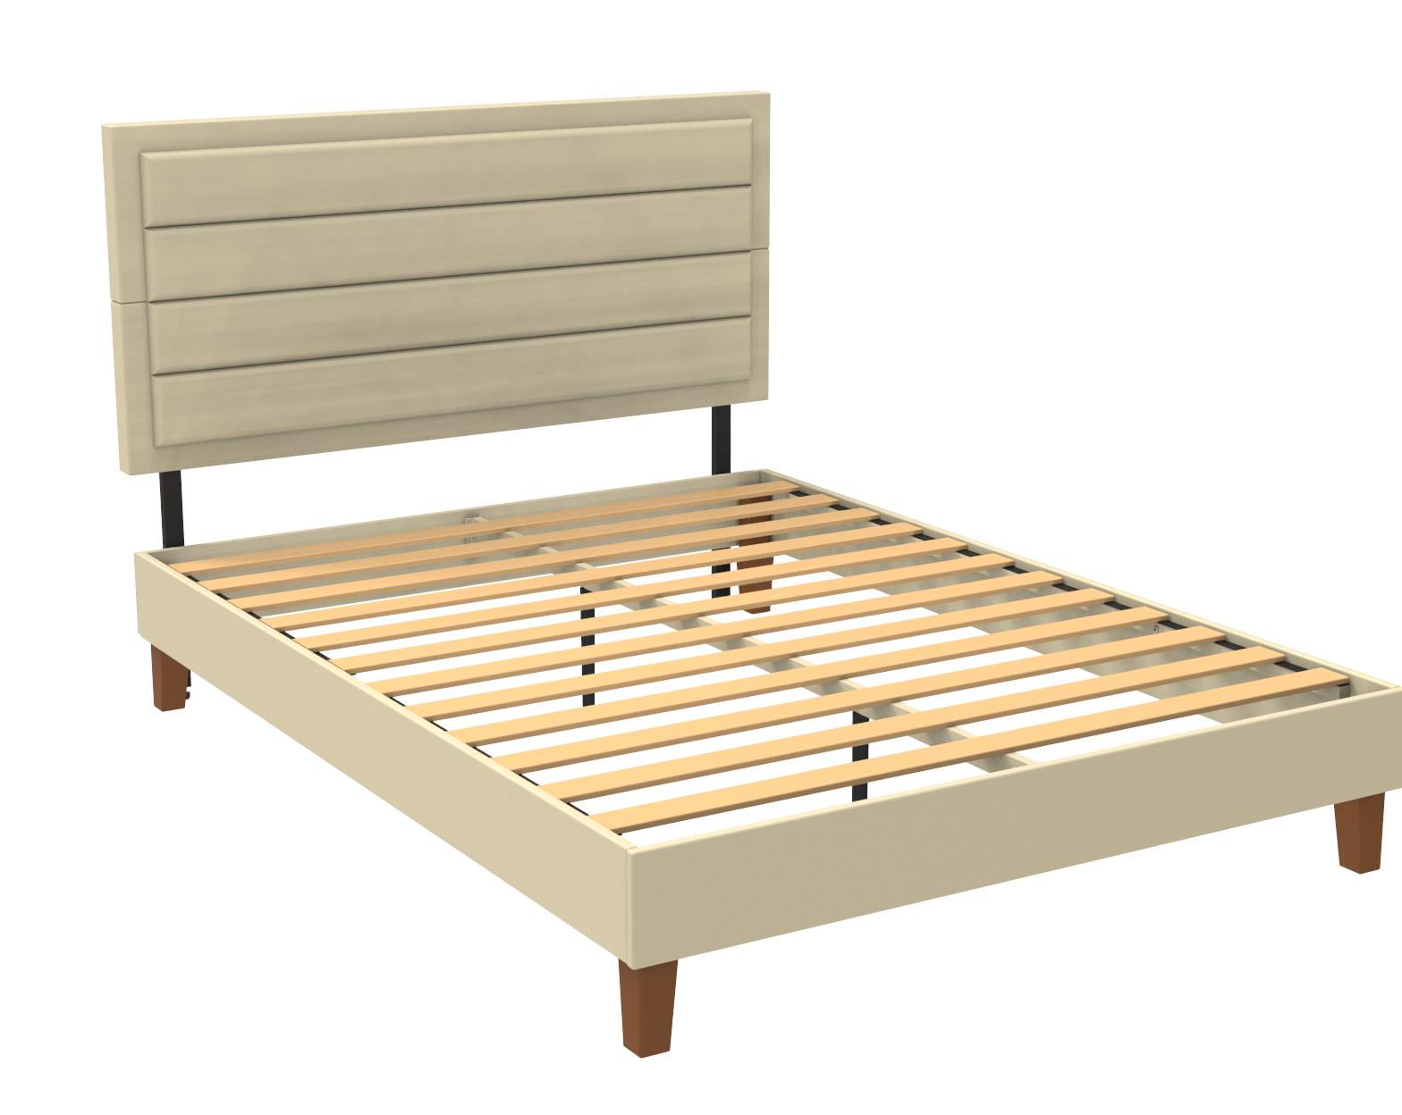
BMLY6UH_00__| Upholstered Platform Bed
QUEEN SPEC
60.2”
27.6”
47”
6.4”
80.2”
3.43”
13.4”
7”
59.8”
81.7”
6”

Slide 6
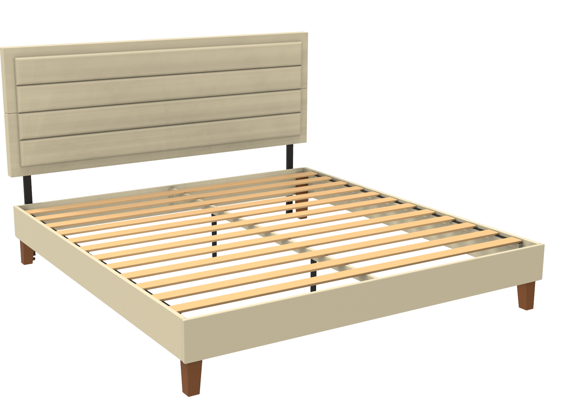
BMLY6UH_00__| Upholstered Platform Bed
QUEEN SPEC
76.2”
27.6”
47”
6.4”
80.2”
3.43”
13.4”
7”
75.8”
81.7”
6”

Slide 7
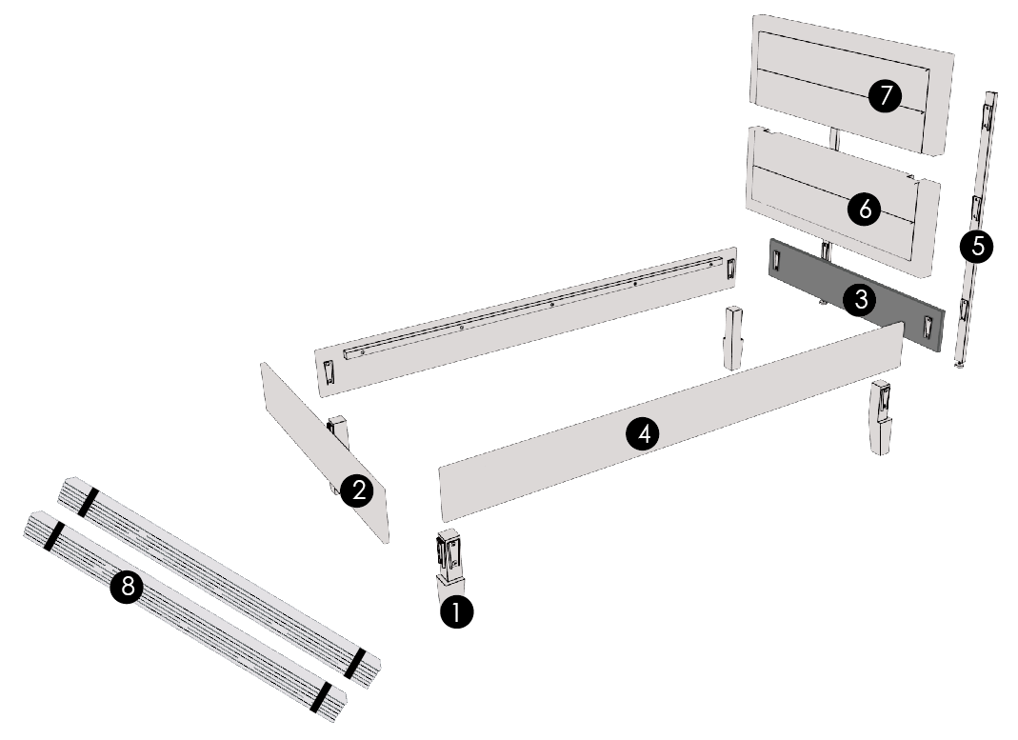
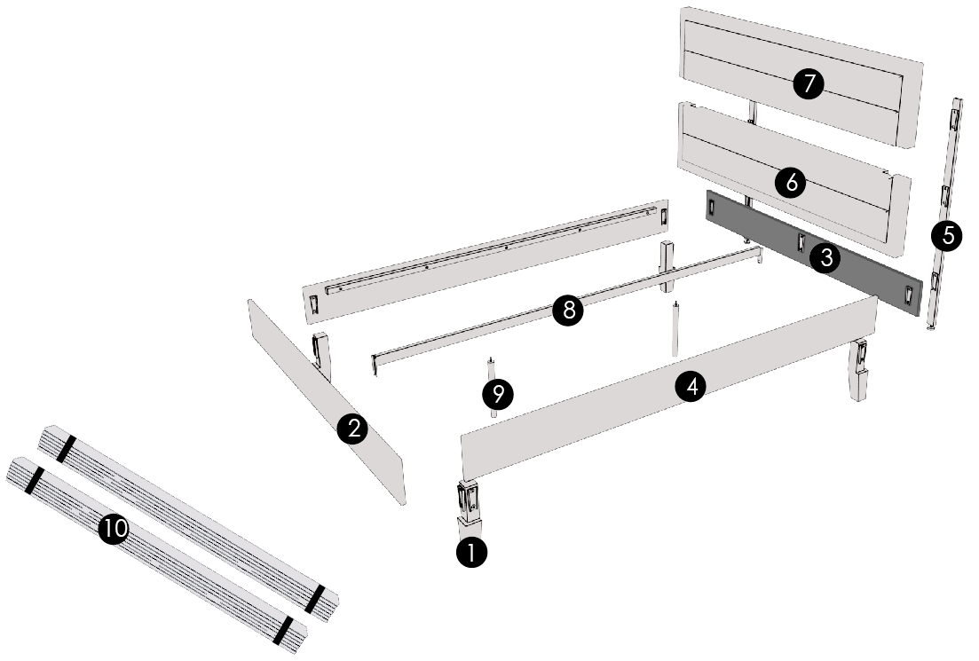
BMLY6UH_00__| Upholstered Platform Bed
TWIN EXPLOSION
F/Q/K EXPLOSION

