Slide 1
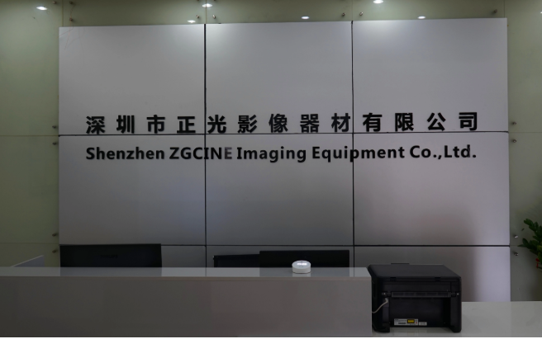
About us
Company Introduction
About Us
Shenzhen Zhengguang Imaging Equipment Co., Ltd. is a photographic equipment
manufacturer which specializes in R&D, manufacturer, sales and after-sales servce.
The R&D capability, manufacturing technology and product quality all surpass those of
similar manufacturers, creating more convenient and higher-end Video photographic
accessories for domestic and foreign customers.
Our products include Wireless Lavalier Microphone, Universal Shotgun Microphone,
LED Video light, Video Cage,Gimbal Stabilizers Accessories,phone Tripod,and other
photography related equipment, and strive to create higher-end Video photographic
accessories for domestic and foreign customers.
Most of our products are compatible with CE,FCC,ROHS.
Sample, trial order ,OEM order are acceptable.
Sincerely expect your cooperation with us.

Slide 2
Shenzhen Zhengguang Imaging Equipment Co., Ltd.
深圳市正光影像器材有限公司
Professional Manufacturer of photography equipment
1
Vlogging kit
2020
2
Video conference kit
3
Wireless Lavalier microphone
4
LED video light
5
Stabilizer & camera cage
12

Slide 3
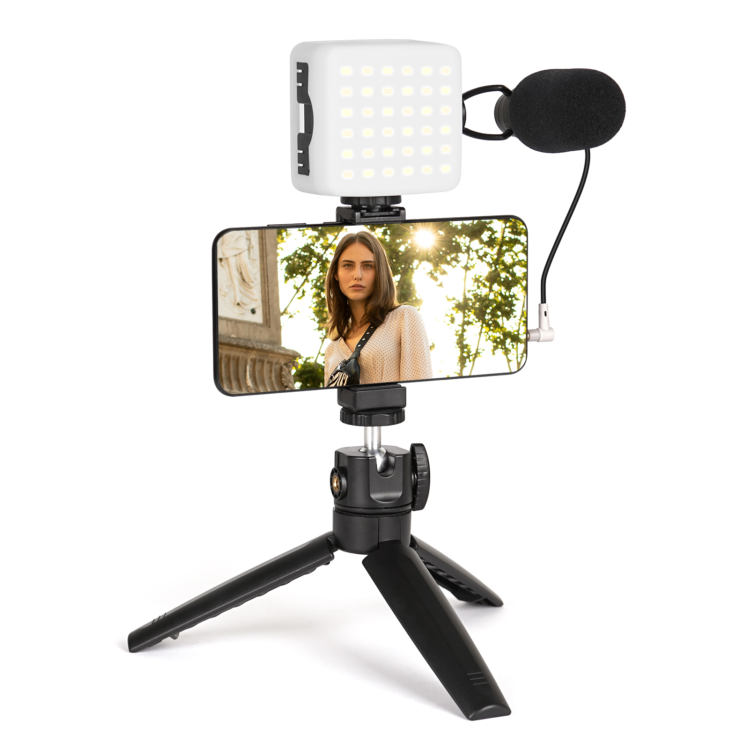
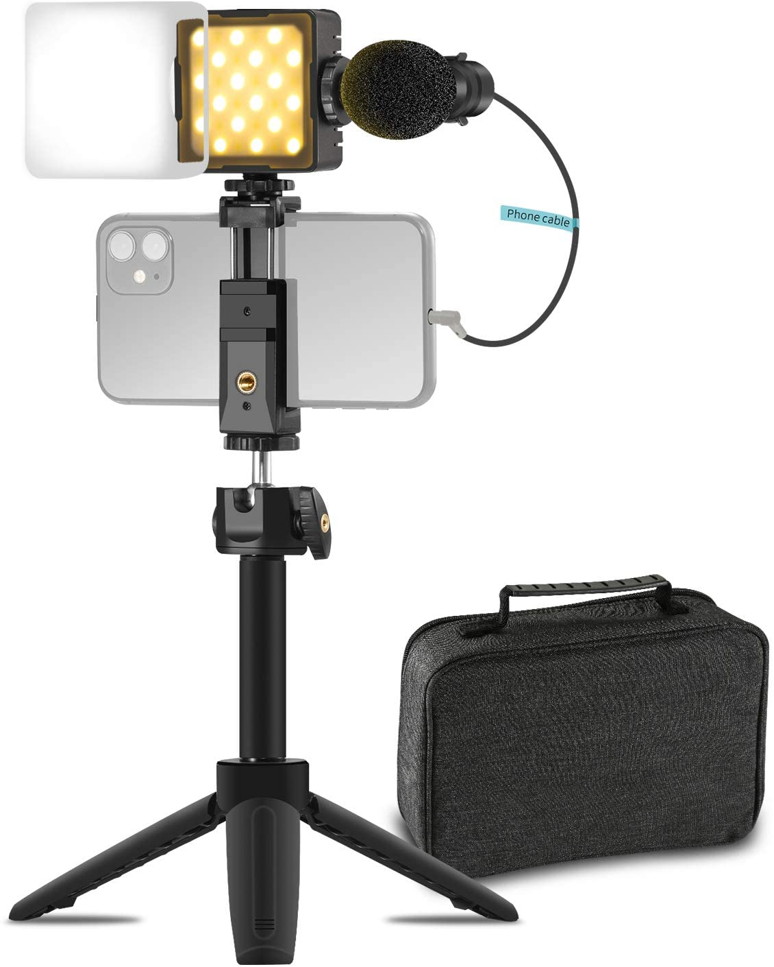
01
Vlogging kit
Smartphone Vlog Kit with Microphone, LED Light and phone holder
Metal shotgun Microphone:
1.Sensitivity Range ： -40±2dB RL=0.68KΩ Vs=1.5V( 1KHz 0dB=1V/Pa)
2.Impedance ： Max. 0.68KΩ1KHz (RL=0.68KΩ)
3.Frequency ： 80-16000 Hz
4.Current Consumption ： Max.0.5mA
5.Operation Voltage Range ： 1.0V-10V
6.Max. Sound Pressure Level ： 110dB S.P.L
7.S/N Ratio ： More than 70dB
7.Sensitivity Reduction ： 1.5V-1.0V Sensitivity Variation less than 3dB
LED light with LCD Display with diffuser:
1.Bulds Quantity: 36pcs(18pcs warm light+18pcs cold white light)
2.Brightness adjustment range: 0-100%
3.Applicable batteries: 3.7V 2000mAh
4.Color Temperature: 2800K-8500K
5.Charging Type: Type-c(Support 5V 1A charging)
6.Average Life time:120 minutes at 8500k 100% brightness
Plastic Mini Tripod with/without extension pole
Ball head: 360° rotation
Material: ABS
Plastic Phone Holder:
Weight: 60g
Mobile phone clip size: 58-105mm
Interface: standard 1/4 screws & standard cold shoe

Slide 4
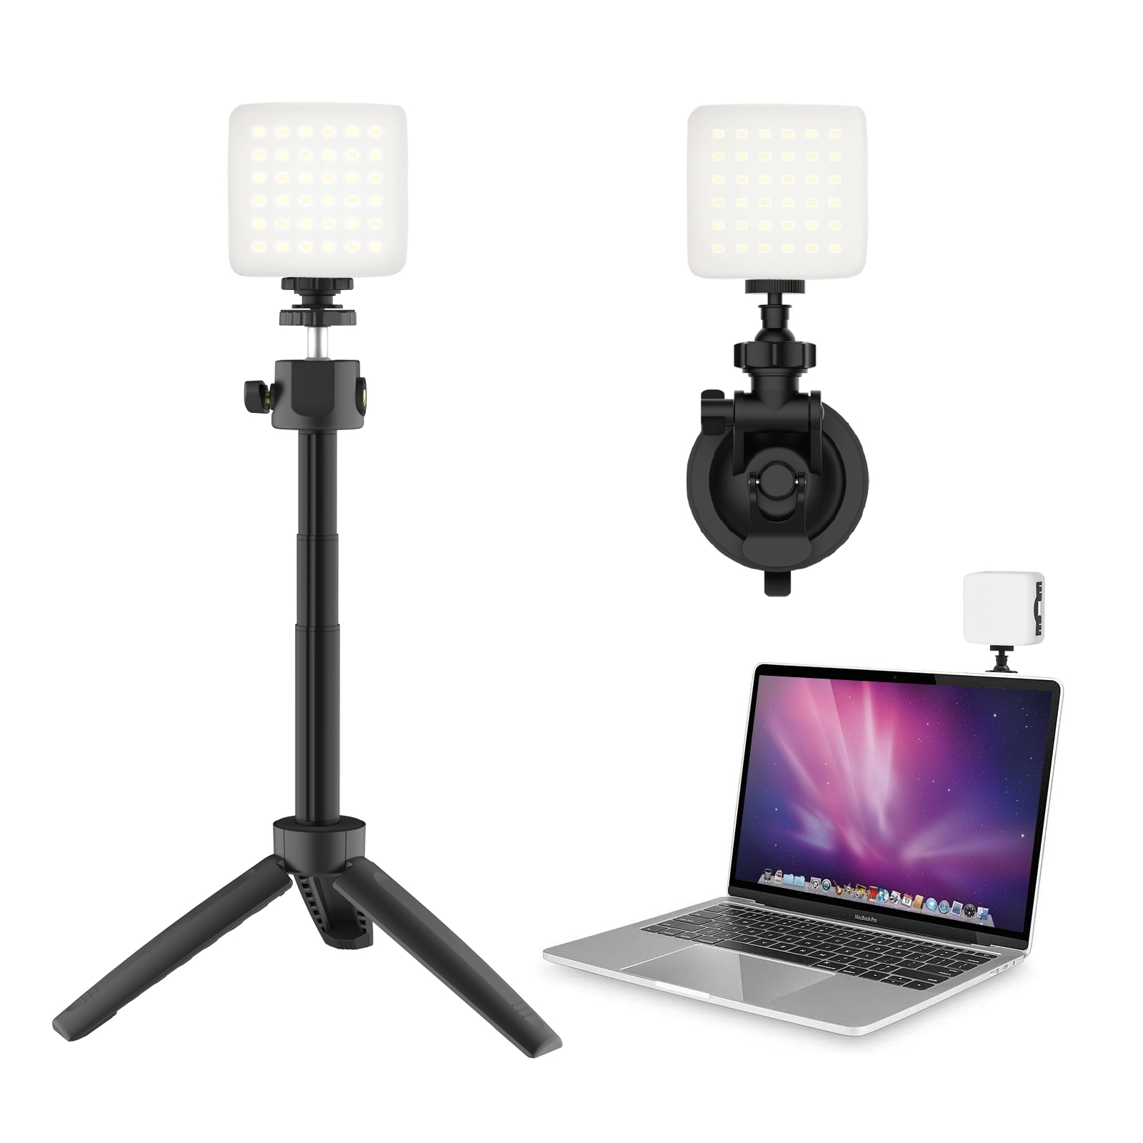
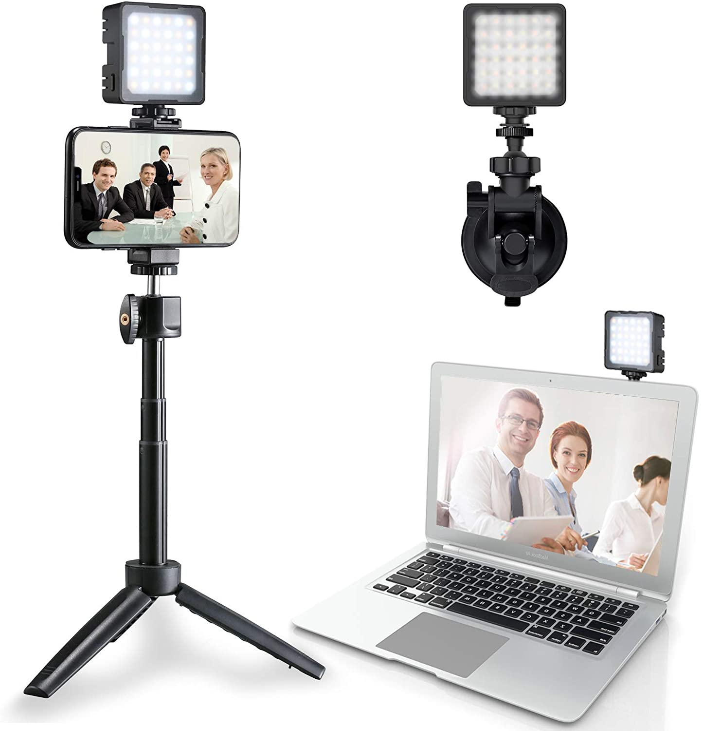
02
Video conference lighting kit
Video Conferencing | Remote Working | Zoom Call Lighting
| Self Broadcasting and Live Streaming
LED light with LCD Display:
1.Bulds Quantity: 36pcs(18pcs warm light+18pcs cold white light)
2.Brightness adjustment range: 0-100%
3.Applicable batteries: 3.7V 2000mAh
4.Color Temperature: 2800K-8500K
5.Charging Type: Type-c(Support 5V 1A charging)
6.Average Life time:120 minutes at 8500k 100% brightness
Plastic Mini Tripod with/without phone holder
Ball head: 360° rotation
Material: ABS
Removable difusser
Make the light natural ,soft and not dazzling
Material: silicon cover
Removable extension pole
Size:8cm-15.5cm
Material: Aluminium
Suction Cup
Max load:0.5KG
Material: ABS

Slide 5
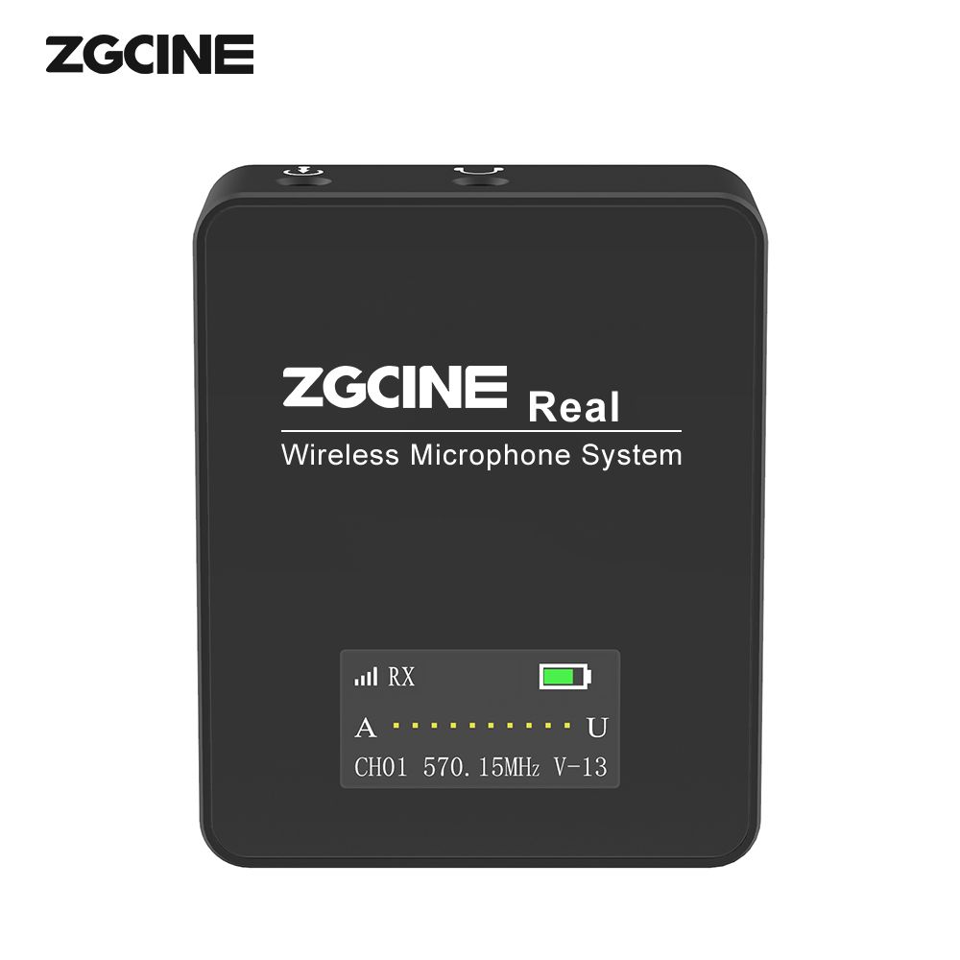
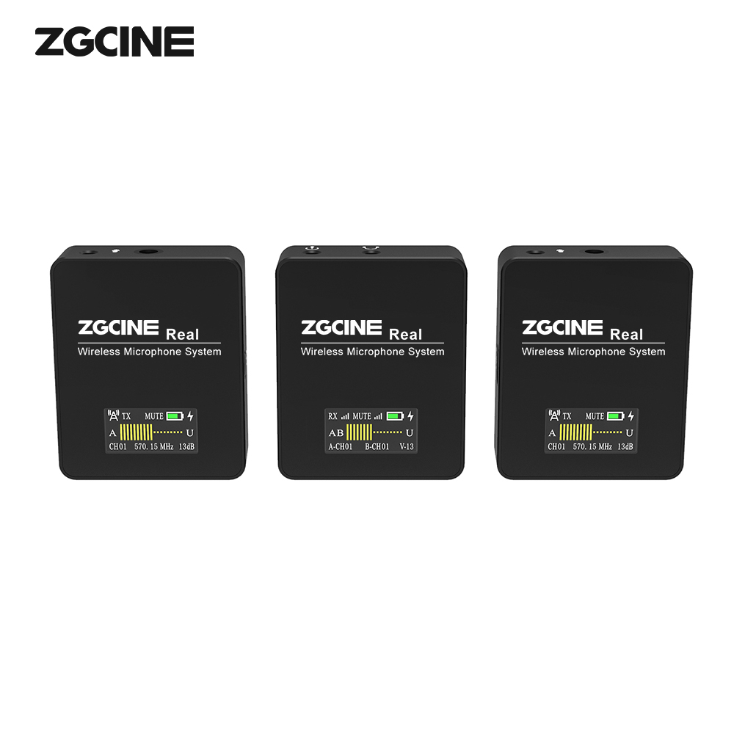
03-1
UHF Wireless Lavalier Microphone
Build in Microphone,Double OLCD Screen Display,
Real-Time Monitoring
1.Raw material:ABS+ Acrylic
2.Battery:600mAh
3.Frequencies:570-606 Mhz
4.Channels:36 channels
5.Working Time:6 hrs
6.Operating range: 229.6 ft70meters
7.Charing Time: 1.5 hours
8.SNR: >90dB
9.Pick-up Mode: Omnidirectional
10.Charging Power: 5V/1A
11.Display: OLED Screen
12.Weight: 70g/0.15lb
13.Dimensions:55x46x15mm/2.17x1.81x0.59 inch
Accessories:
1-2 x Transmitter 1V1 or 1v2 version
1 x Receiver
1-2 x Lapel Microphone
1x Type-c charging cable
1 x Phone cable
1 x Camera cable
1 x Users Guide

Slide 6
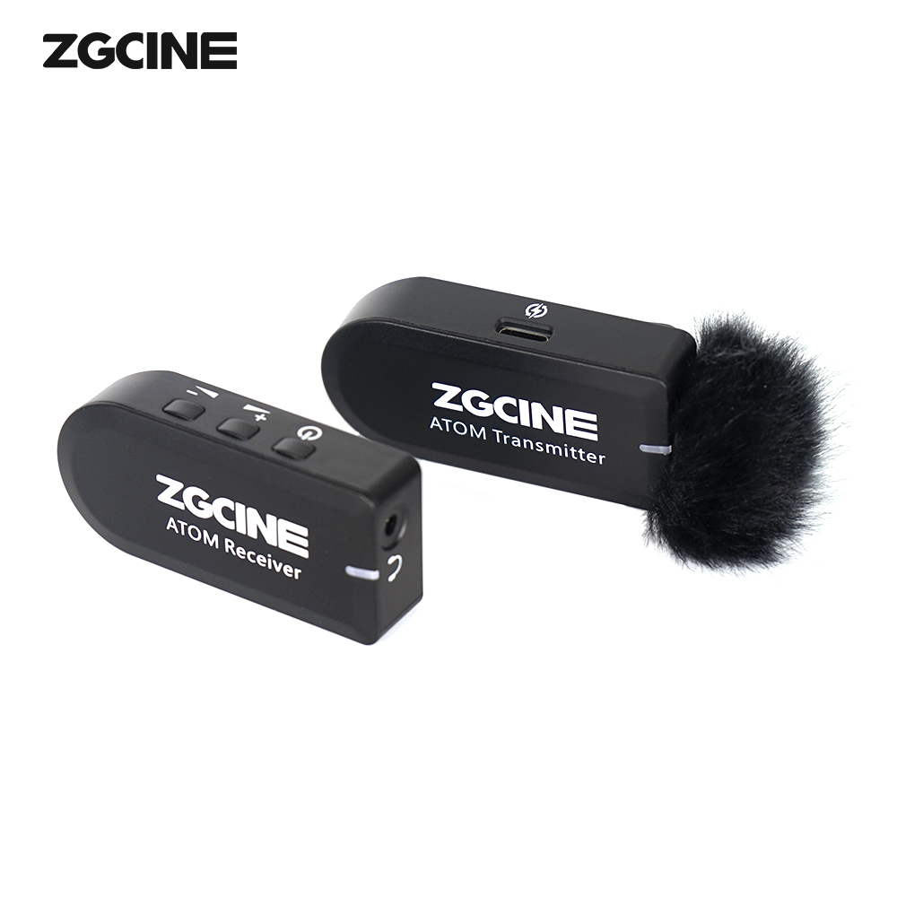
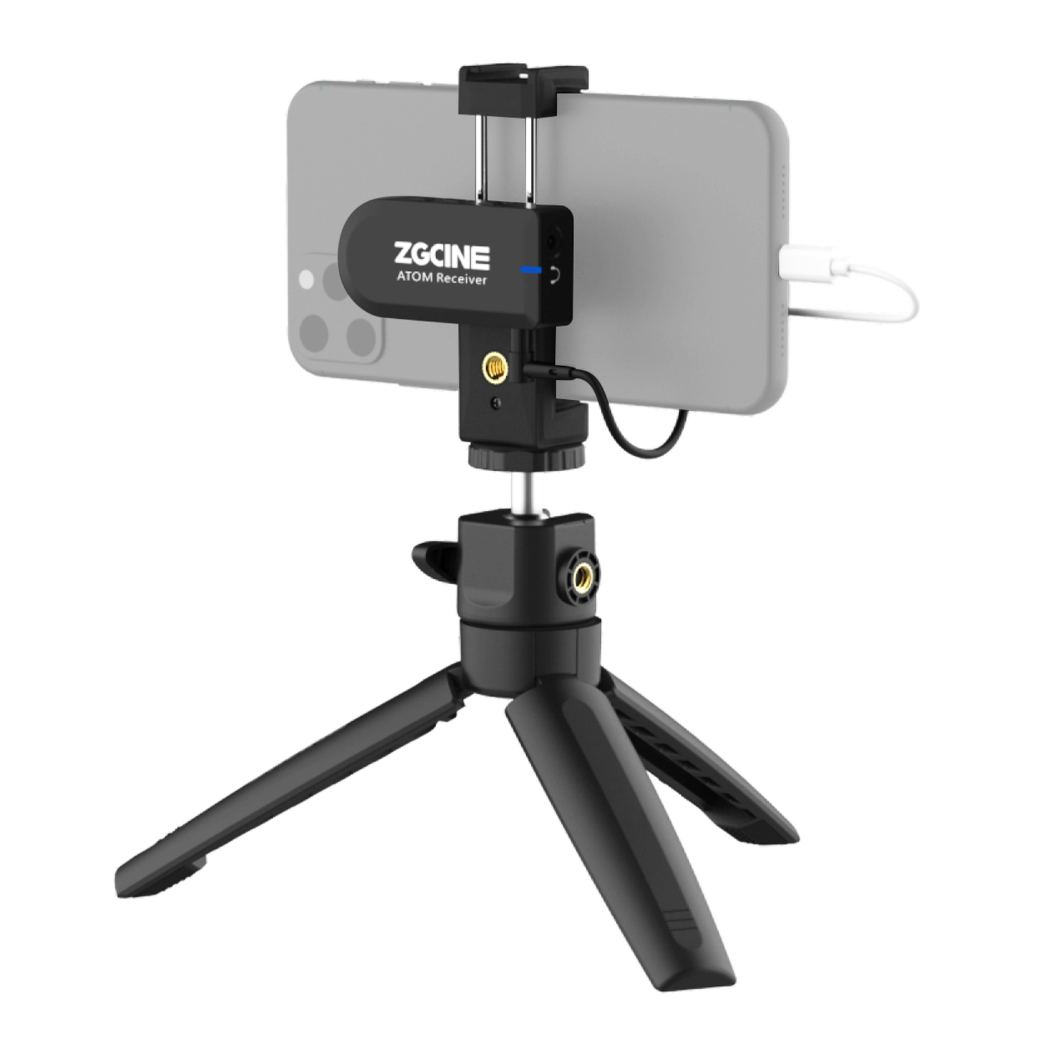
03-2
2.4G Wireless Lavalier Microphone
Build in Microphone.
Specially Designed Wind Muff
Real-Time Monitoring
Transmission Type: 2.4G
Pickup Mode: Omnidirectional
Battery Endurance: 6h
Service distance: 30M
Charging Power :5V 1A
Product size:63*31*16mm
Weight:28g
Accessories:
1-2 x Transmitter 1V1 or 1V2 version
1 x Receiver
1-2 x Lapel Microphone
1-2 x Type-c charging cable
1 x Phone cable
1 x Camera cable
1xTripod 2x wind muff
1 x Users Guide

Slide 7
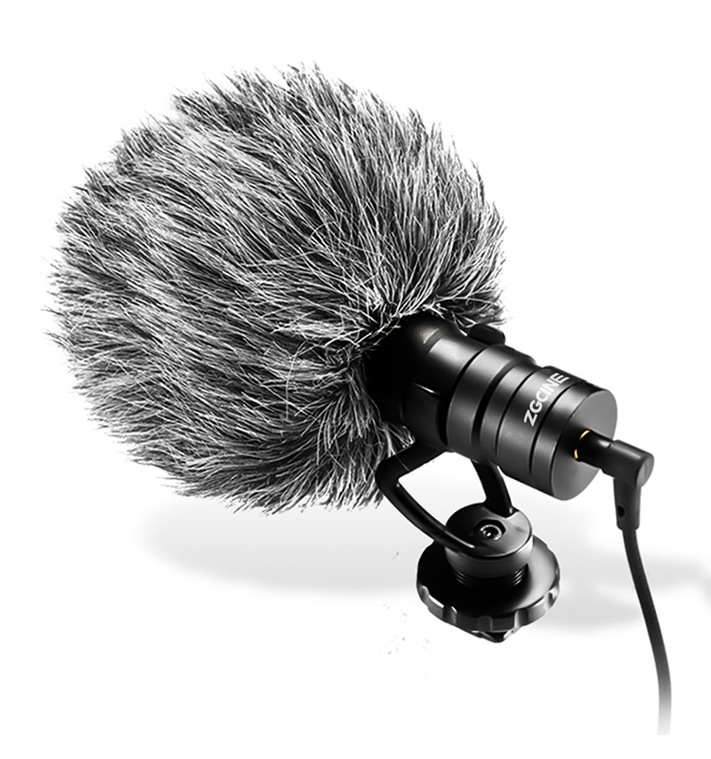
03-3
Shotgun Video Microphone
Metal shotgun Microphone:
1.Sensitivity Range ： -40±2dB RL=0.68KΩ Vs=1.5V( 1KHz 0dB=1V/Pa)
2.Impedance ： Max. 0.68KΩ1KHz (RL=0.68KΩ)
3.Frequency ： 80-16000 Hz
4.Current Consumption ： Max.0.5mA
5.Operation Voltage Range ： 1.0V-10V
6.Max. Sound Pressure Level ： 110dB S.P.L
7.S/N Ratio ： More than 70dB
7.Sensitivity Reduction ： 1.5V-1.0V Sensitivity Variation less than 3dB
Accessories:
1x Mic Body
1x Mic Shock mount
1x Mic Windscreen
1x Mic Wind Muff
1x Smartphone Audio Cable
1x Camera Audio Cable
Accessories include Phone holder&Tripod is available

Slide 8
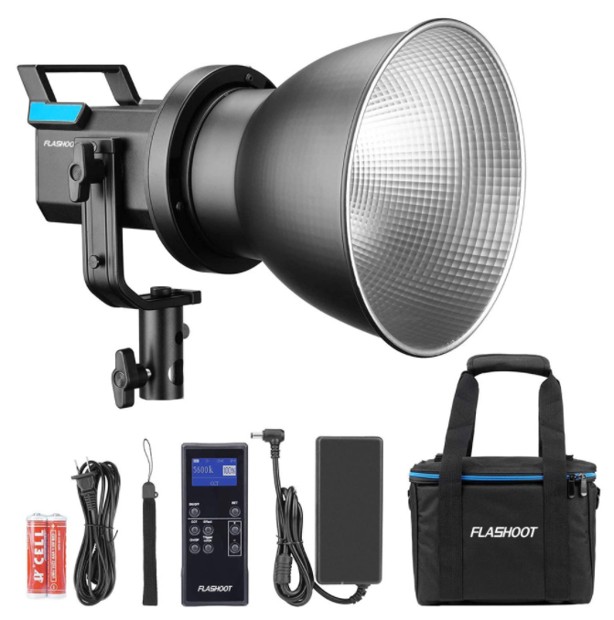
04
LED Video Light X60
Features:
1.Powerful 80W LED bead offers high light brightness and stable illumination.
2.CRI 96+ TLCI 95+ insure Natural, Pristine Color.
3.Wirelessly adjusts light brightness via 2.4G remote controller.
4. 6 Groups & 12 Channels.
5. 5 Pre-Programmed Lighting Effects.
6.Excellent heat dissipation.
7.Specially designed to protect cover to protect the LED bead.
8.More efficiency by Hyper Reflector.
* AC Power Supply: DC 15V, 6A 2.adapter(AC100-240V 50/60Hz)
* Channel: 12
* Group: 6 Group(A, B, C, D, E, F)
* Power: 80W
* Color Temperature: 5600±200K
* CRI: 96+
* R9: 90
* TLCI: 95+
* Dimming range: Adjustment 11.brightness mode 1%-100%,
* effect mode 10%-100%
* Operating temperature: -10 to 50 ℃
* LED beads safety 15,temperature: ≤70℃
* Size:173.7x122.5x201mm
*

Slide 9
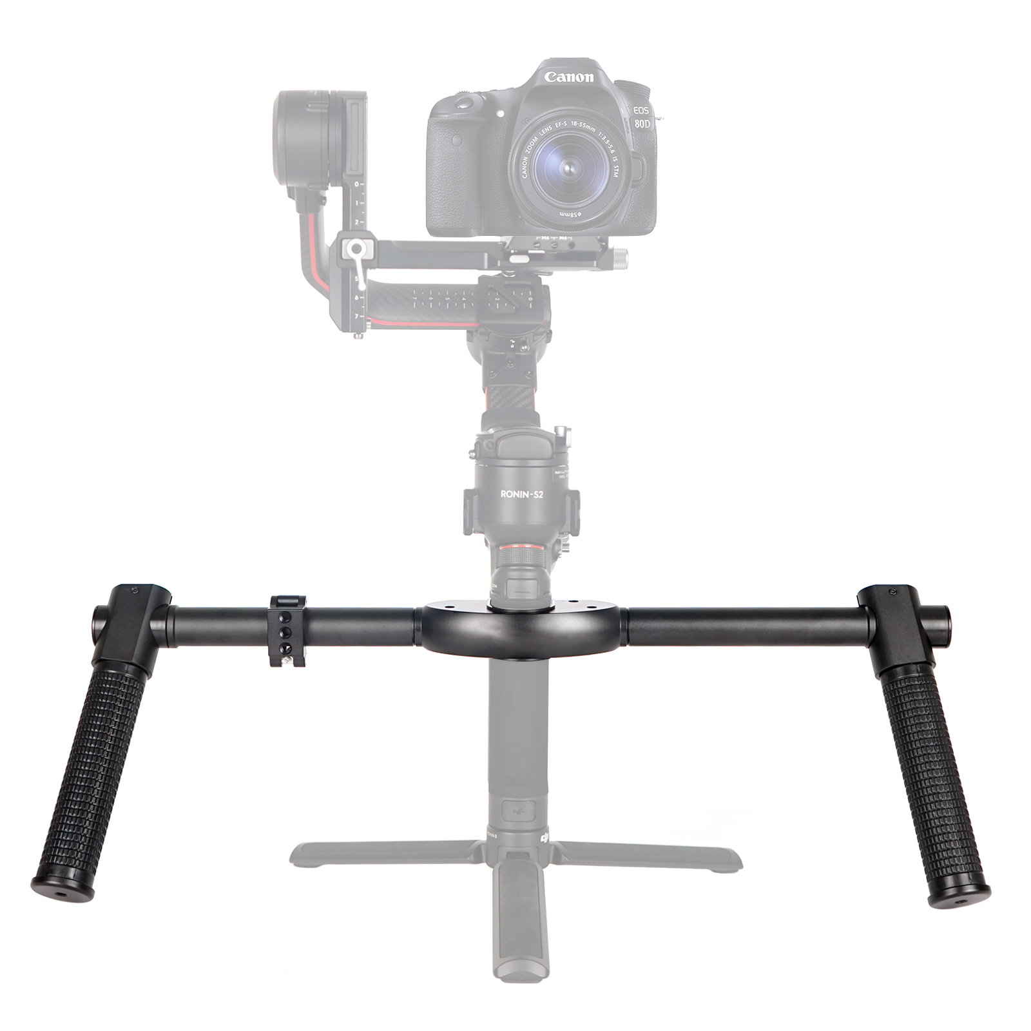
05
Stabilizer & camera cage
Dual handle grip is specially designed for DJI Roin S/Ronin SCII/
MOZA Air 2 Gimbal Stabilizer.Made of Aerospace Aluminum Alloy,
lightweight, solid and durable.
1/4 Screws on the grip, offers multiple accessory mounts, providing
full support for add-on such as connecting monitor, bluetooth remote or
any other accessories with your cameras.

Slide 10
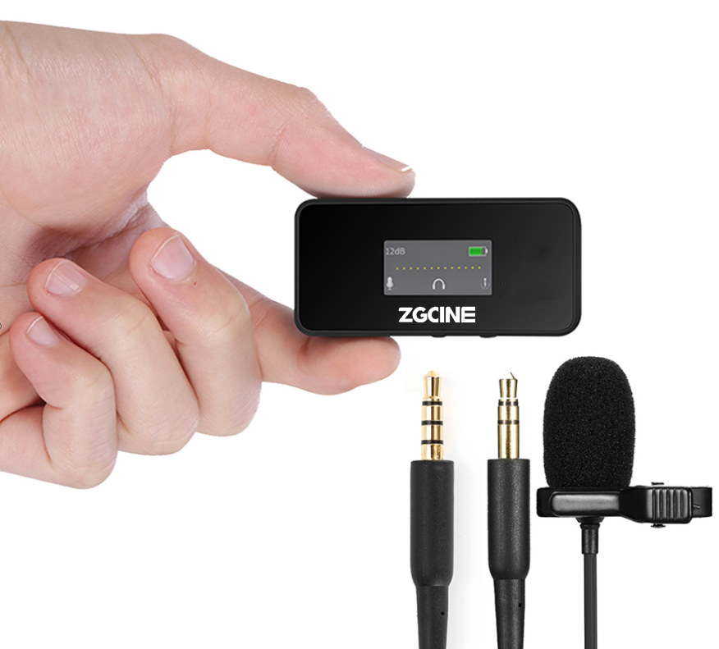
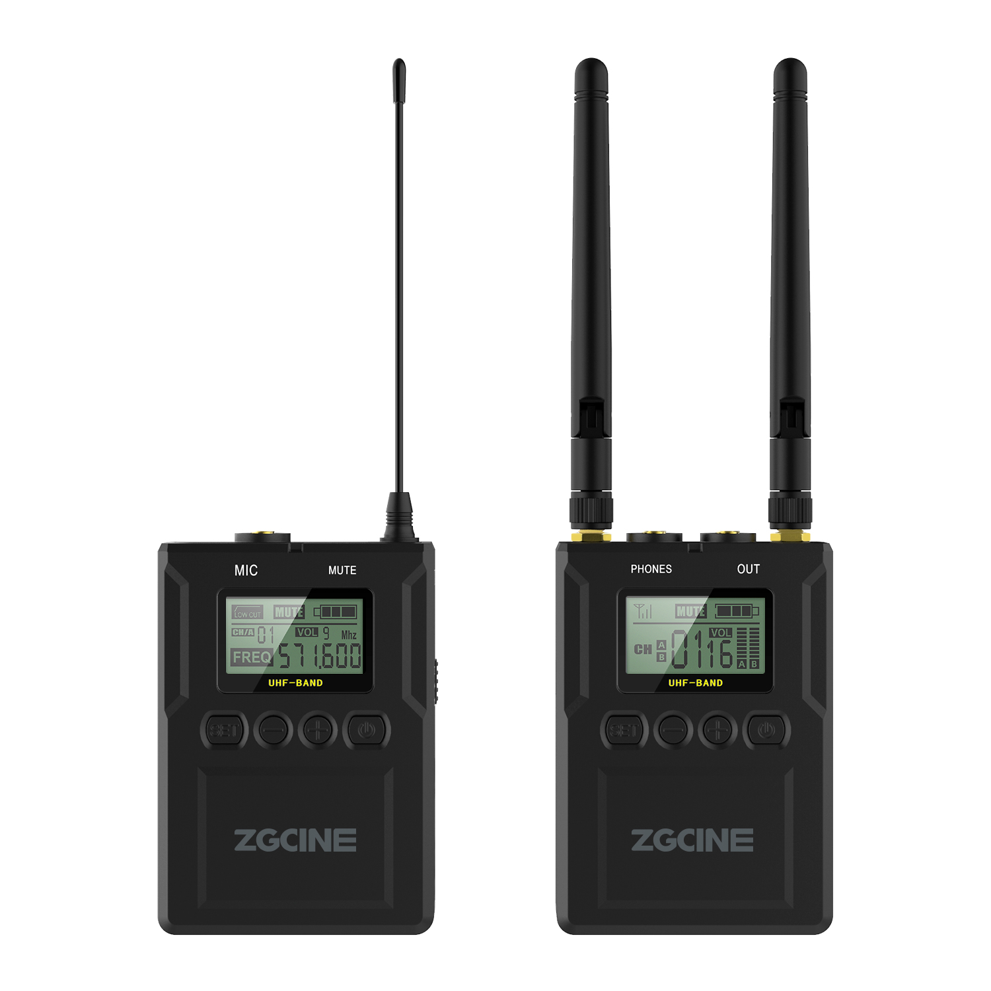
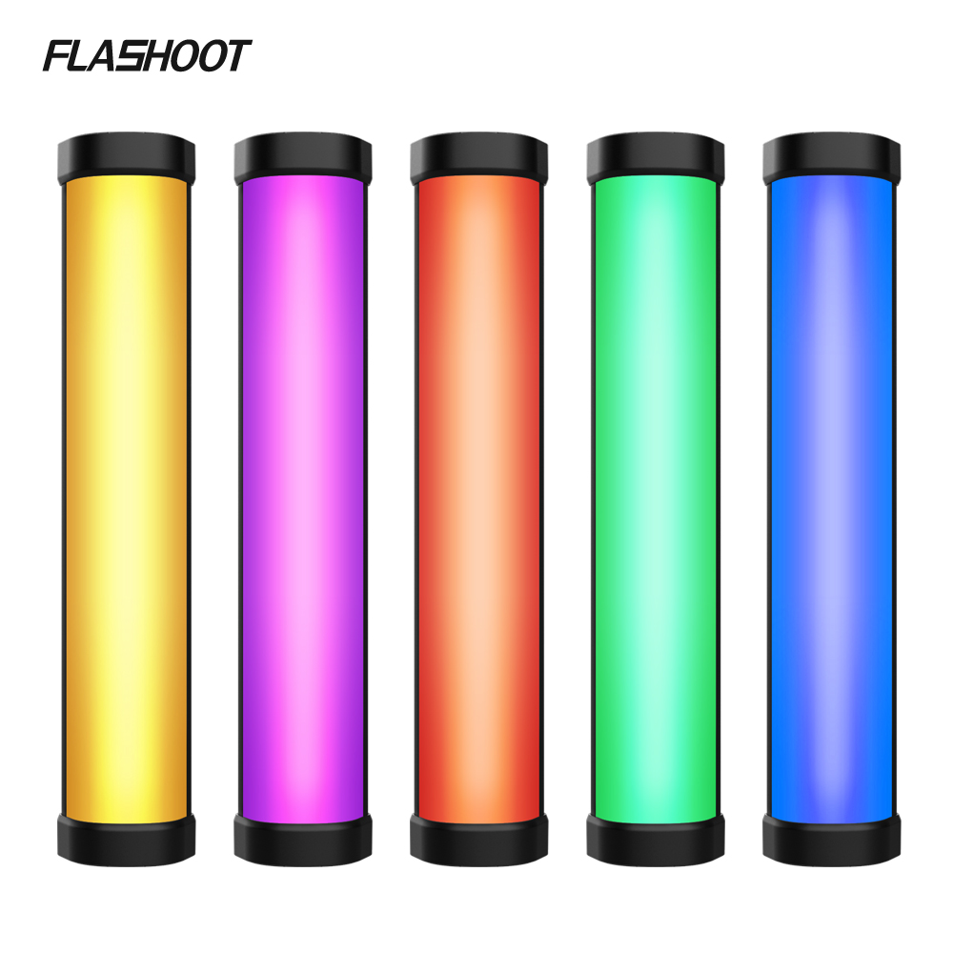
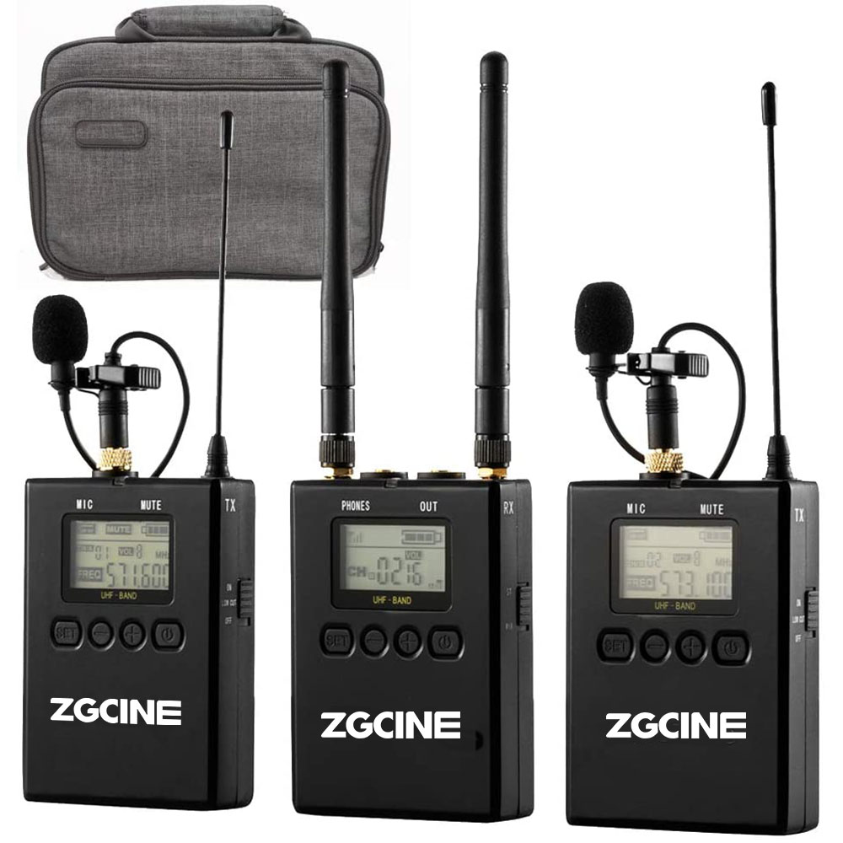
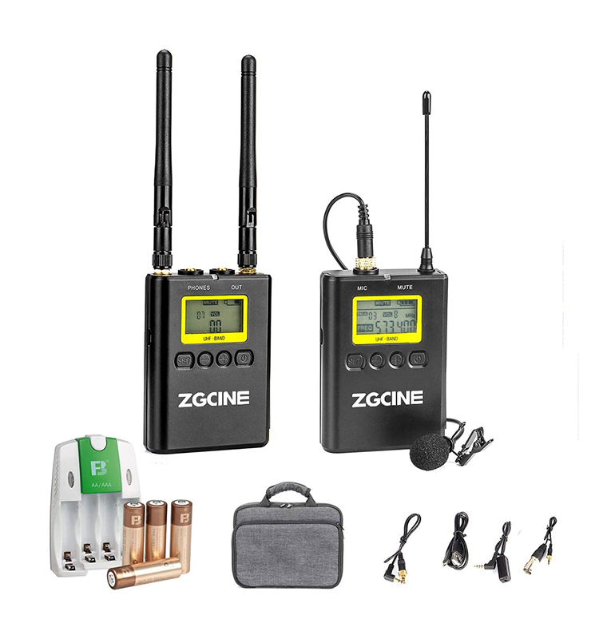
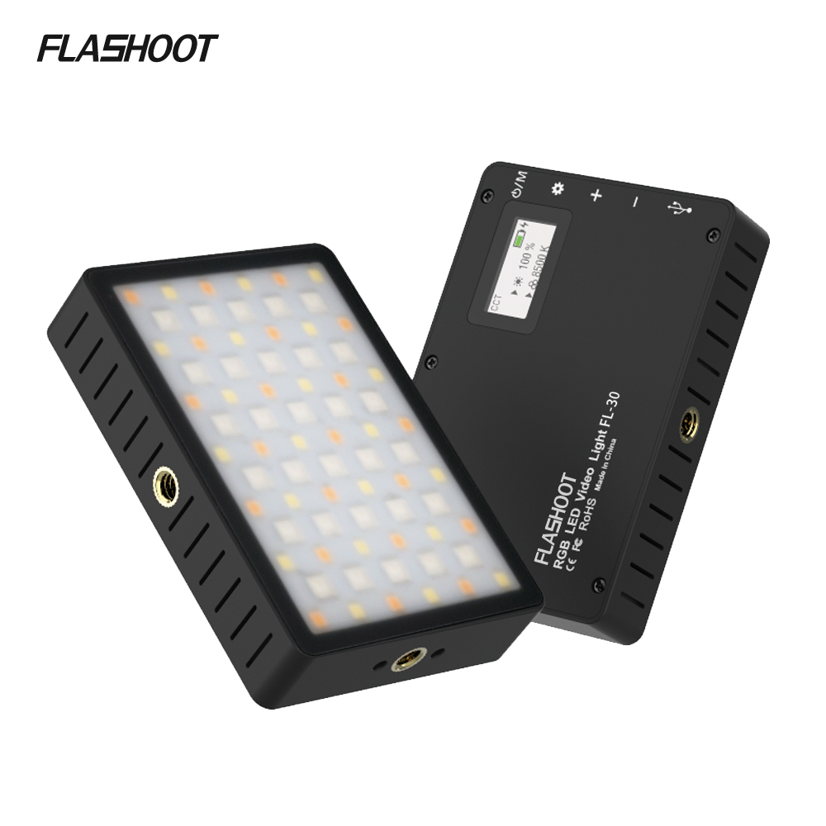
More Products
06

Slide 11
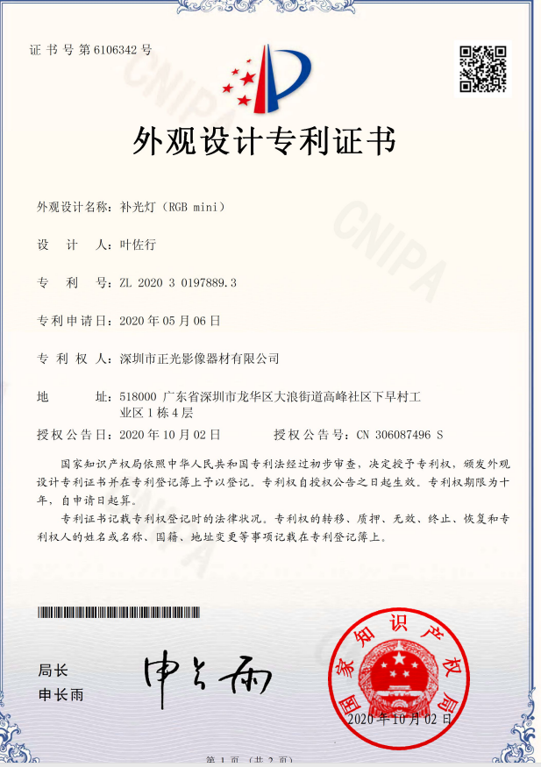
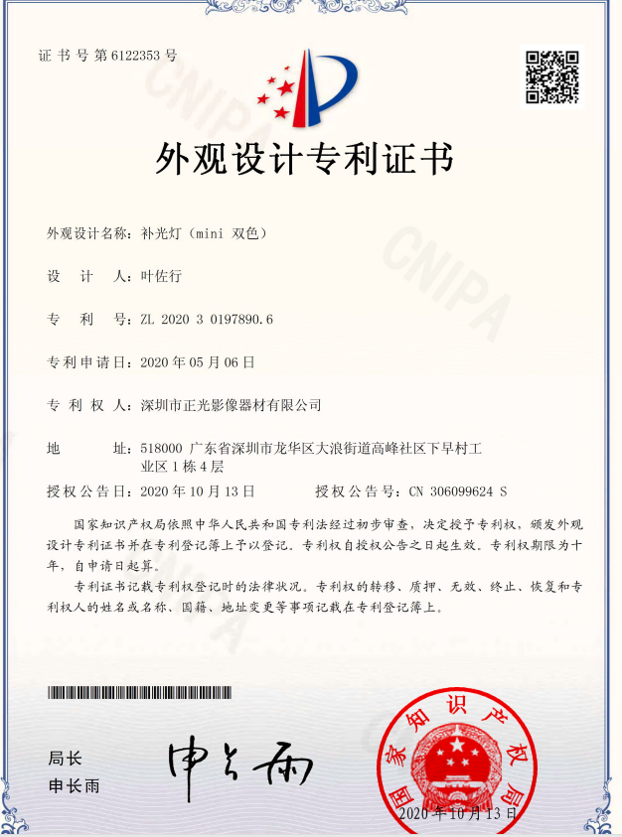
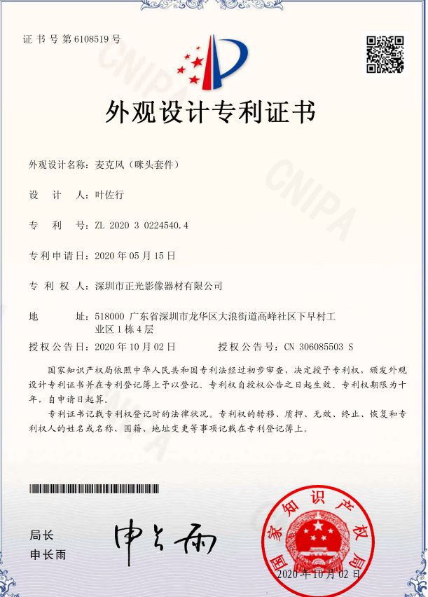
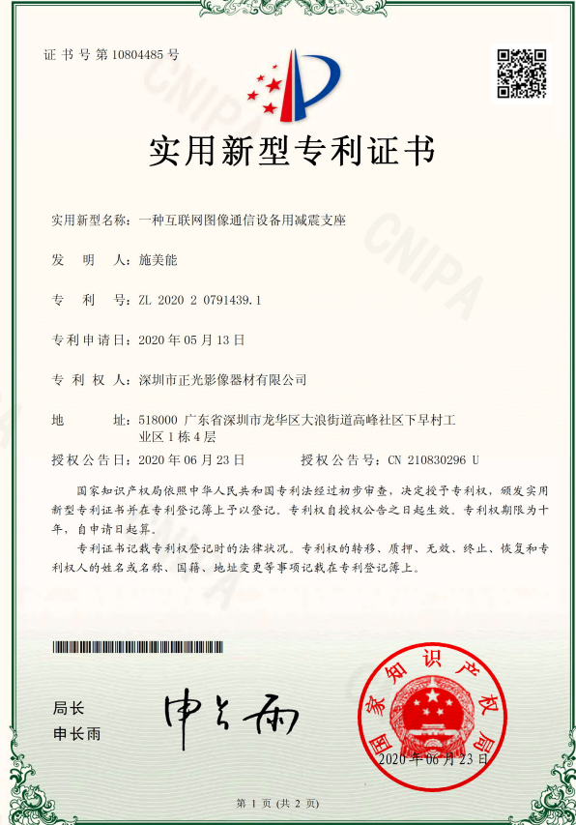
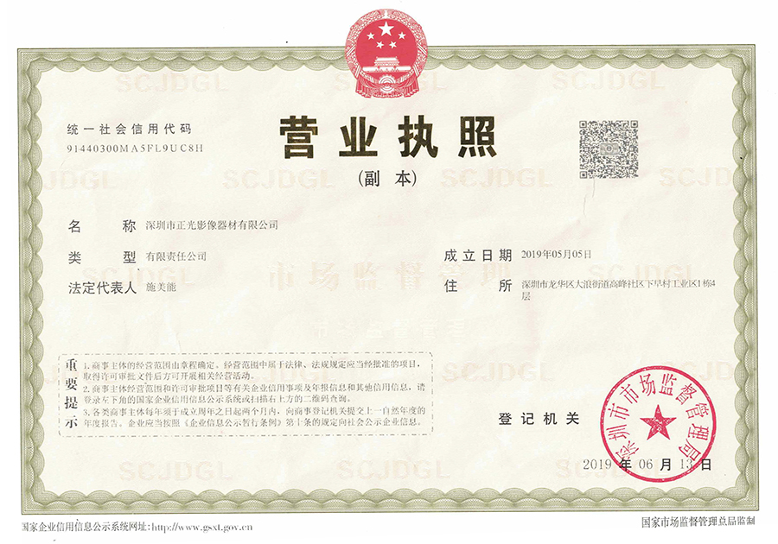
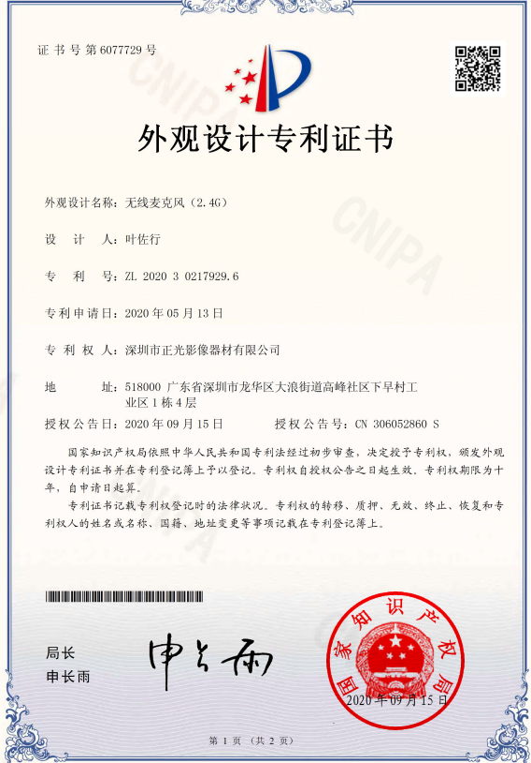
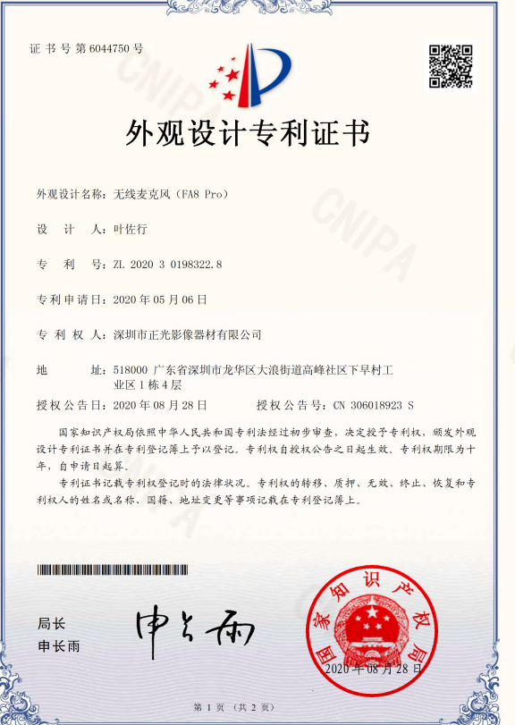
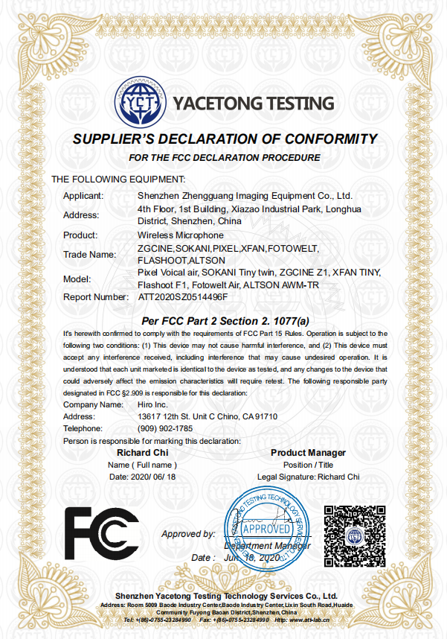
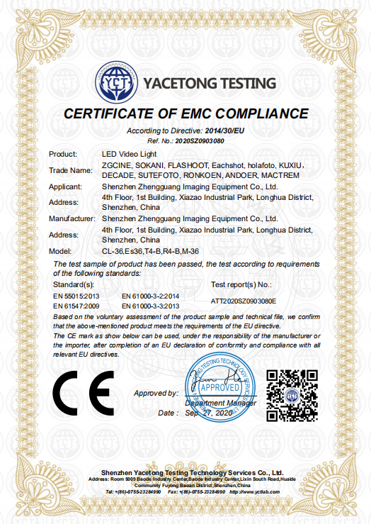
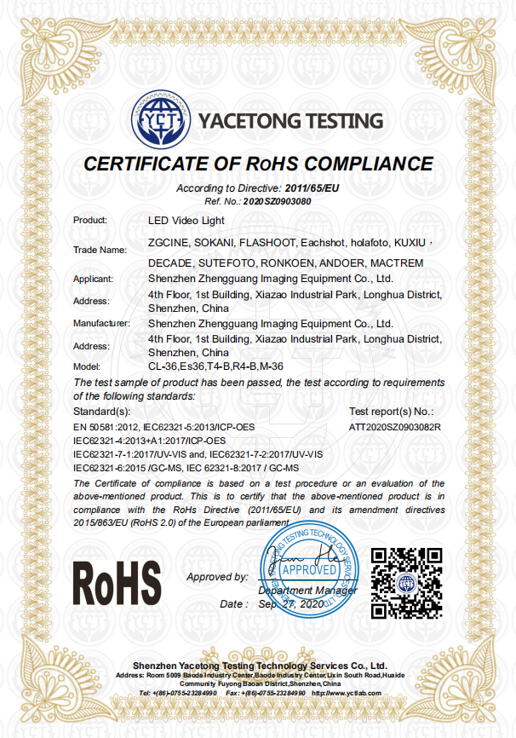

Slide 12
Contact us
https://zgcine.en.alibaba.com
www.zgcine.com
Site
Tel
0086 755 2941 5015
Email
info@zgcine.com
BECOME OUR PARTNER
4th Floor,1st Building,Xiazao Industrial
Park, Longhua District,Shenzhen, Guangdong,
China 518109
Add

