Slide 1
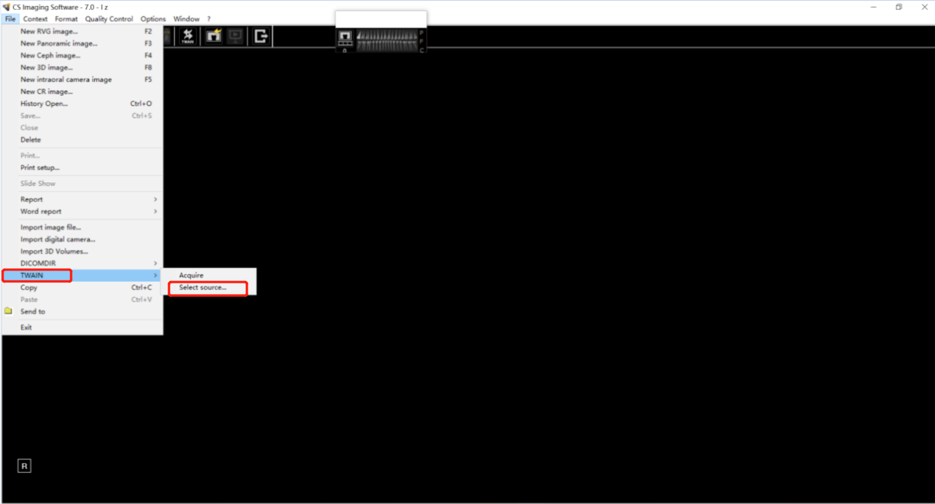
The first time when you use Eighteeth Twain function, install Eighteeth Twain at first. After the installation is complete, operate the releated software,find its“TWAIN” ,choose “Select source”

Slide 2
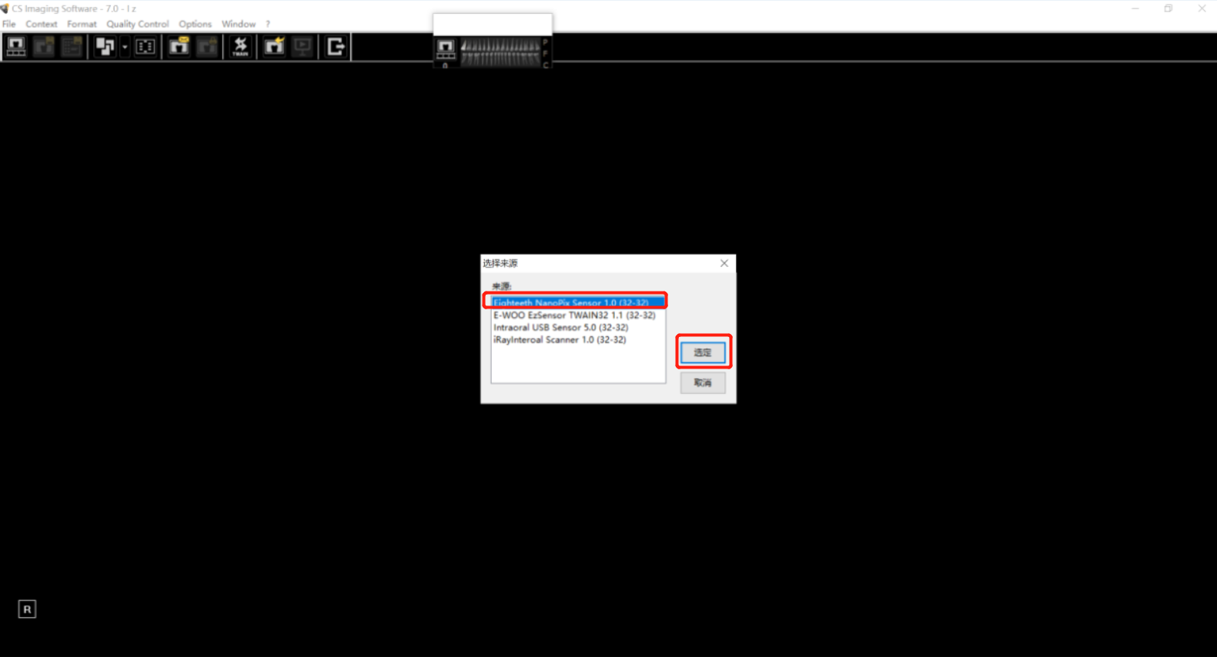
Then you will come to this interface,choose”Eighteeth NanoPix Sensor”

Slide 3
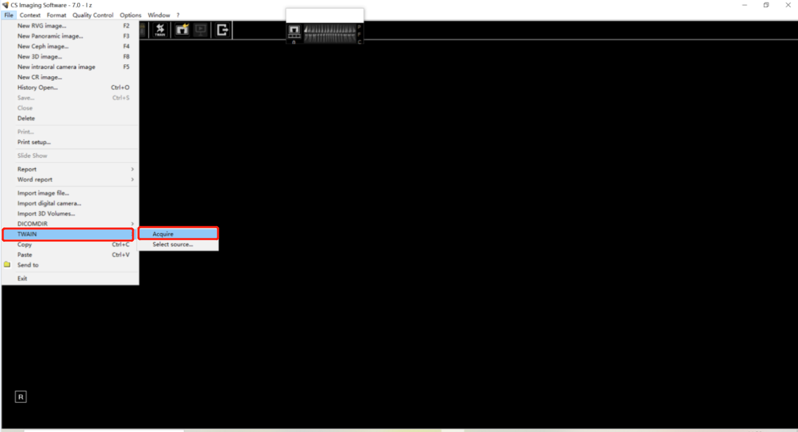
Now back to this interface,choose”Acquire”

Slide 4
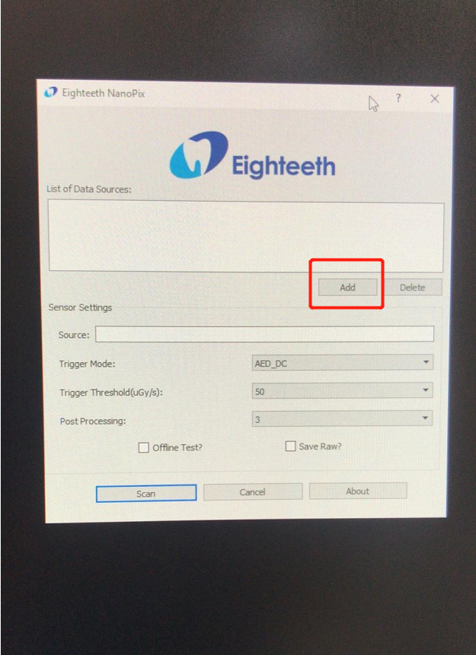
After choosing”Acquire”,will show this. Choose”Add”,find the NanoPix calibration file in your computer, add that file.

Slide 5
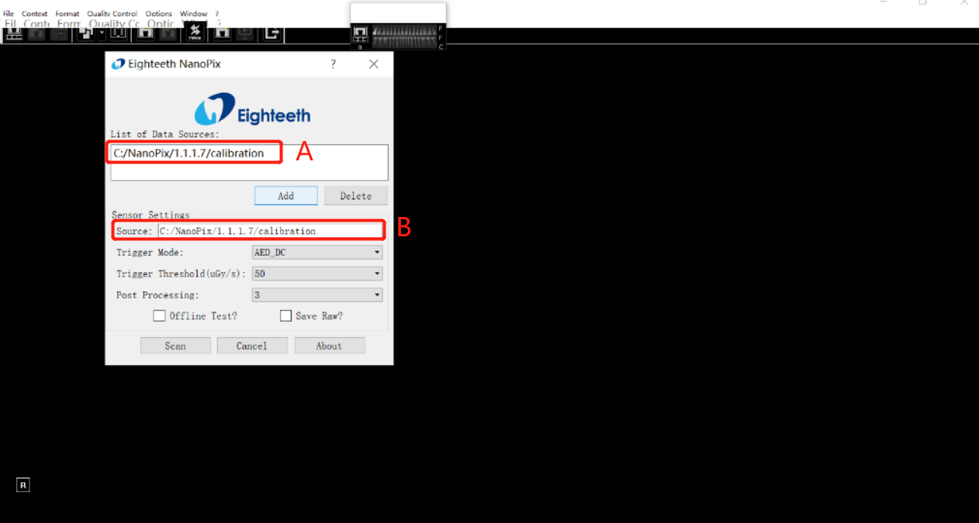
After that, Part A will show the calibration file, double click Part A, then Part B will show the same content, it means the import is successful. And then press ”Scan”.

Slide 6
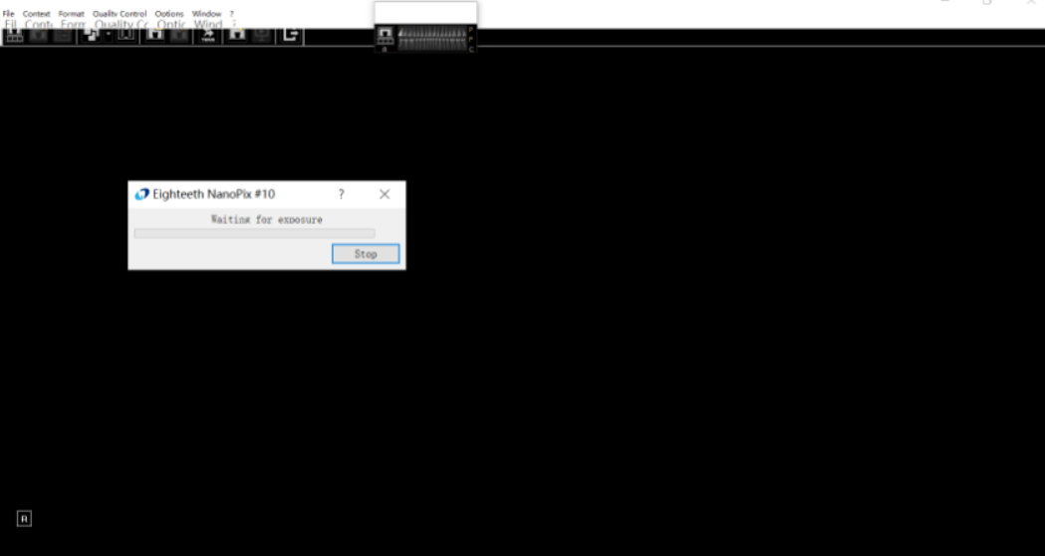
After pressing ”Scan”, will come to this interface. Now you can go ahead with exposure.

