Slide 1
AGM-GLORY(SE,PRO,G1) Force Clear Data Tutorial

Slide 2
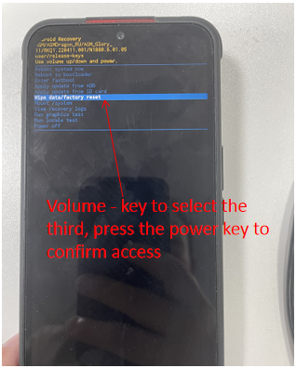
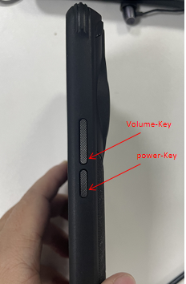
Step 1: Turn the phone off and long press the power key + volume up key
1、Long press the power key + volume up key, into the recovery mode
2、This is the recovery mode interface

Slide 3
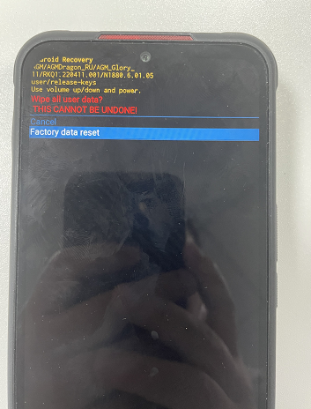
Step 2: Go to the Clear Data Recovery Reset screen
1、recovery interface, volume up key is to select, volume down key is to determine.
2、Select factory data reset, press power key to enter
Volume - key to select factory data reset, press the power key to confirm to enter

Slide 4
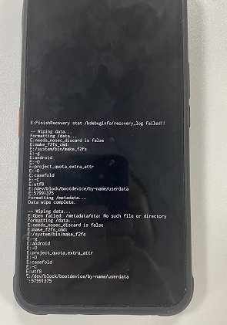
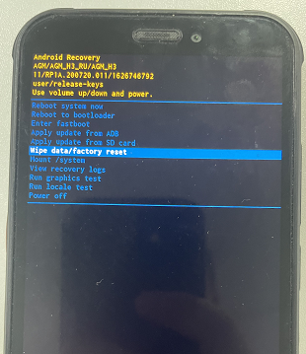
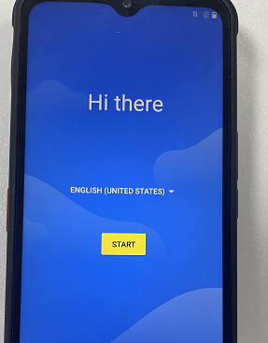
Step 3: Clear data and reboot
Wait for the clear data to finish loading, select power off phone off, and then long press the power key phone on, at this time the lock screen password has been lifted.
After clearing the data volume - key to select power off

Slide 5
Thanks
AGM

